Slide 1
MEDICAL FACILITIES
By
Calvin D’souza : leader
Jayden Gomes
Douglas Pereira
Adam Menon
Sohail Khan

Slide 2
In my region (Mahim) . I interviewed a doctor named nina d‘costa. Doctor told me that in our area there are Many medical labs, private hospitals, government hospitals. Such as Dr. Wilson path lab, srl Phadke path lab. Raheja hospital, hinduja hospital, bmc clinics etc. So there are many medical facilities which are sufficient for the people in my region. Doctor Even told that it is become easy to treat people with modern technology in path labs, private hospitals and government hospitalS. Example surgery’s, check up and many more. Doctor also said that there are many local physicians. Dr. Nina d‘costa who I interviewed was too a local physician.

Slide 3
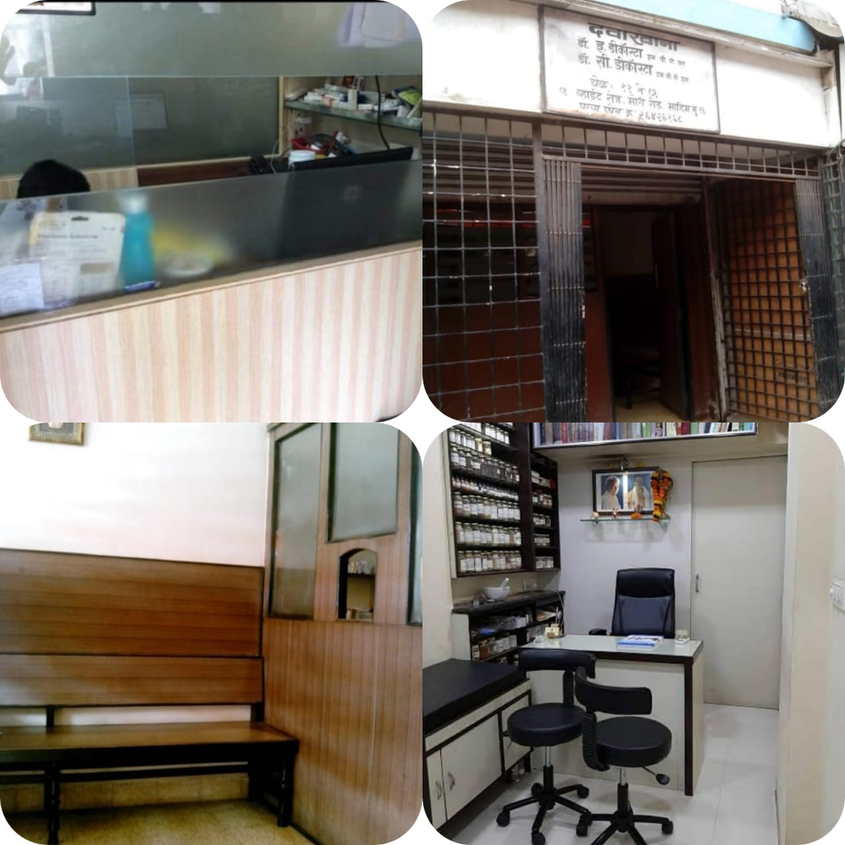

Slide 4
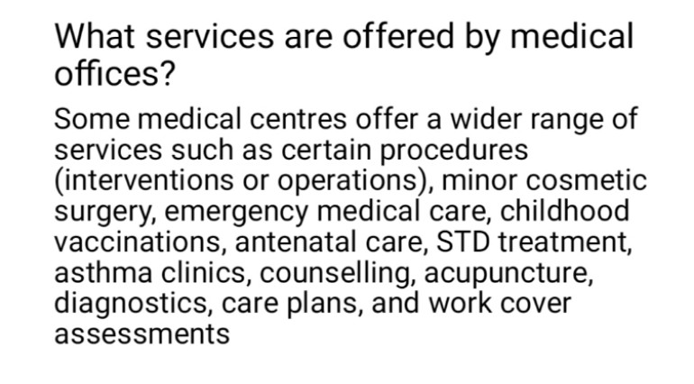

Slide 5
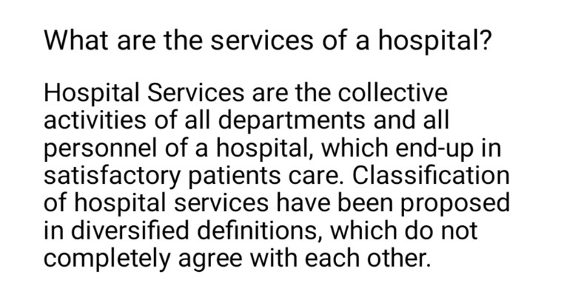

Slide 6
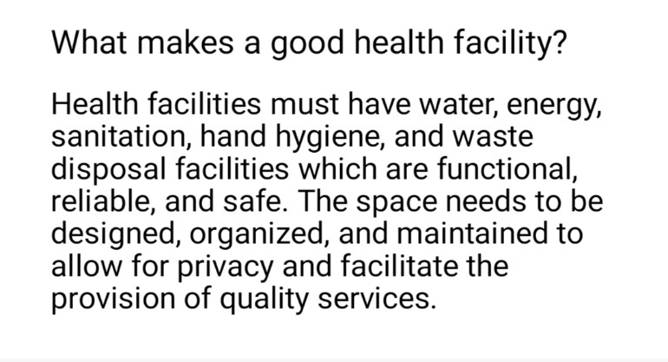

Slide 7
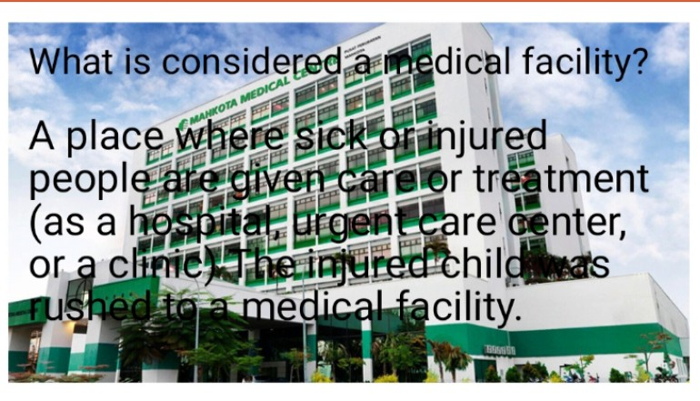

Slide 9
ICU
Intensive care units cater to patients with severe or life-threatening illnesses and injuries, which require constant care, close supervision from life support equipment and medication in order to ensure normal bodily functions. They are staffed by highly trained physicians, nurses and respiratory therapists who specialize in caring for critically ill patients. ICUs are also distinguished from general hospital wards by a higher staff-to-patient ratio and access to advanced medical resources and equipment that is not routinely available elsewhere. Common conditions that are treated within ICUs include acute respiratory distress syndrome, septic shock, and other life-threatening conditions.
Patients may be referred directly from an emergency department or from a ward if they rapidly deteriorate, or immediately after surgery if the surgery is very invasive and the patient is at high risk of complications.
Notes:
Intensive care units cater to patients with severe or life-threatening illnesses and injuries, which require constant care, close supervision from life support equipment and medication in order to ensure normal bodily functions. They are staffed by highly trained physicians, nurses and respiratory therapists who specialize in caring for critically ill patients. ICUs are also distinguished from general hospital wards by a higher staff-to-patient ratio and access to advanced medical resources and equipment that is not routinely available elsewhere. Common conditions that are treated within ICUs include acute respiratory distress syndrome, septic shock, and other life-threatening conditions.
Patients may be referred directly from an emergency department or from a ward if they rapidly deteriorate, or immediately after surgery if the surgery is very invasive and the patient is at high risk of complications.

Slide 11
ICCU
The SCCH Intensive Coronary Care Unit, ICCU, is designed for those patients requiring constant observation, as well as specialized medical and nursing care. Our four ICCU rooms are equipped with the latest technological advances for quality patient care, including cardiac monitoring and management of ventilator patients.
ICCU is also capable of providing telehealth services in multiple disciplines, including cardiology, pulmonology, nephrology, and mental health. Telehealth services use a monitor/webcam, allowing the physician to see, assess, and speak with the patient from off-site locations with the assistance of the on-site nursing staff. Telehealth equipment also provides patients with a means to visit with family that may live too far away to visit in person.

Slide 12
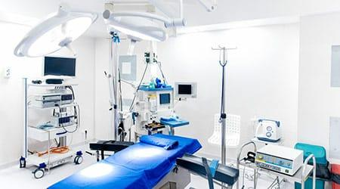

Slide 13
CCU
A coronary care unit (CCU) or cardiac intensive care unit (CICU) is a hospital ward specialized in the care of patients with heart attacks, unstable angina, cardiac dysrhythmia and (in practice) various other cardiac conditions that require continuous monitoring and treatment.

Slide 14
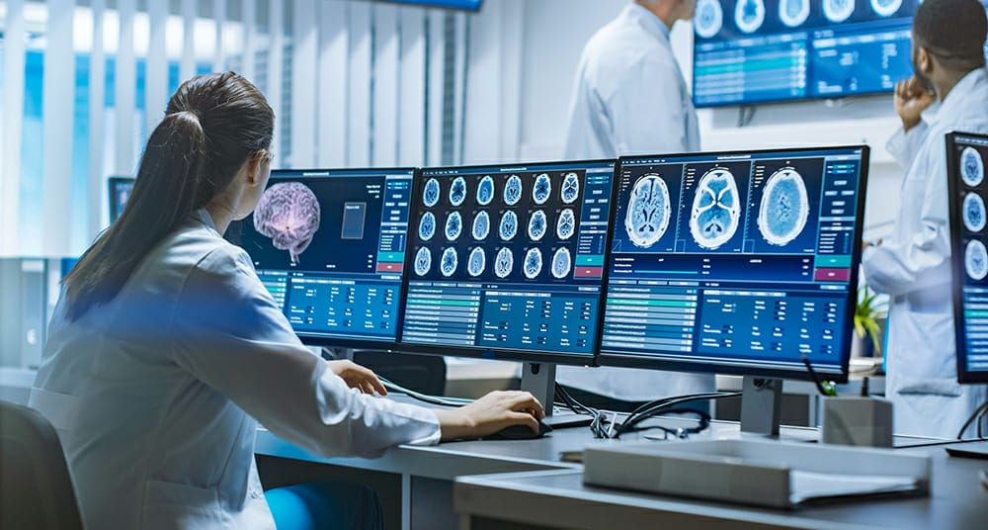

Slide 15
Daycare unit
A day hospital is an outpatient facility where patients attend for assessment, treatment or rehabilitation during the day and then return home or spend the night at a different facility.^{[1]} The patient groups most likely to receive this sort of hospital provision are elderly people, those with psychiatric problems, and those with physical rehabilitative needs. It is also used for some cancer treatments, as at New York's Memorial Sloan Kettering Cancer Center and London's UCH Macmillan Cancer Centre.

Slide 17
THANK YOU

