Slide 1
Local shopping vs online shopping

Slide 2
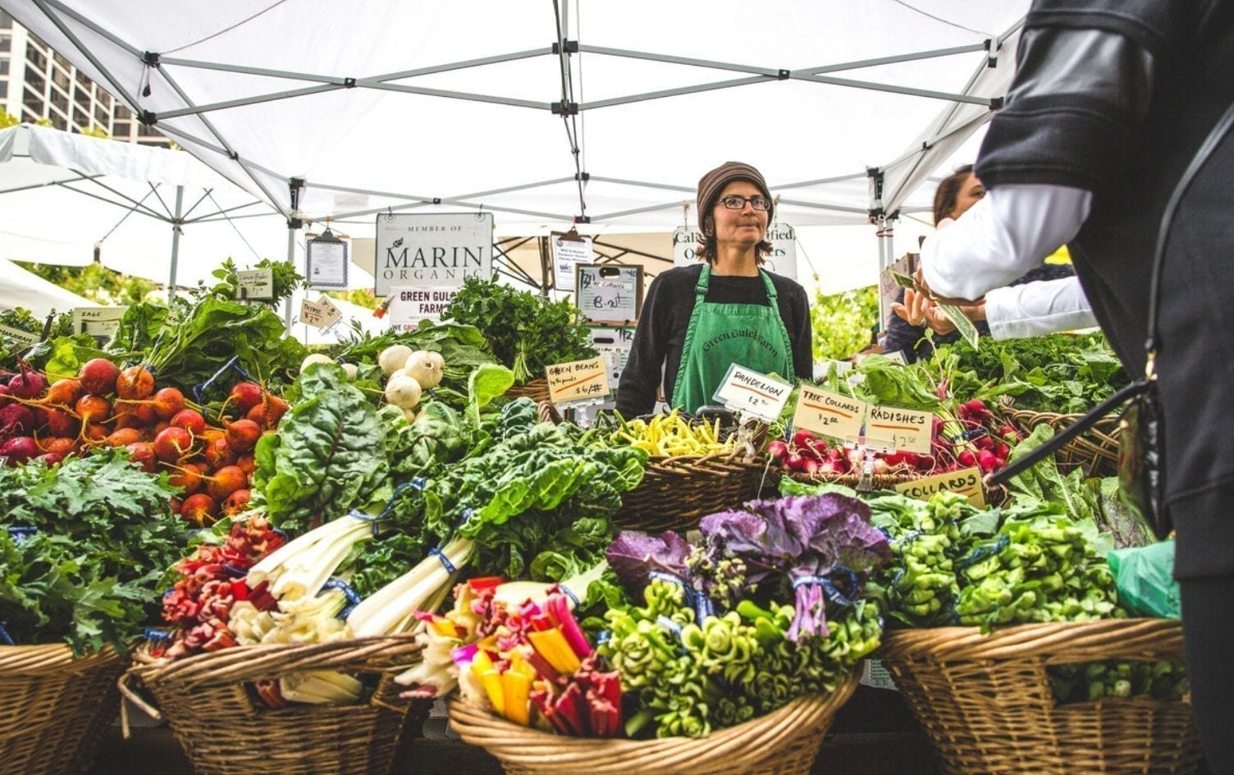
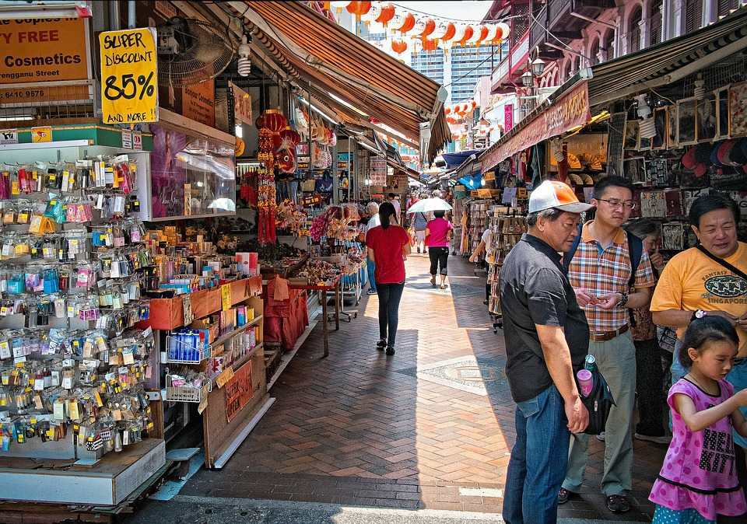
What is local shopping?
Shopping local is the act of everyday consumers, like you, making the decision to buy your produce, clothing and day to day items from a local business instead of going to a large retailer. Shopping locally is the trendy new way to create a one-of-a-kind neighborhood.
Shopping in a local business district means less infrastructure, less maintenance, and more money available to beautify your community. Also, spending locally instead of online ensures that your sales taxes are reinvested in your own community. You can also save money on delivery charges which are required while shopping online.

Slide 3
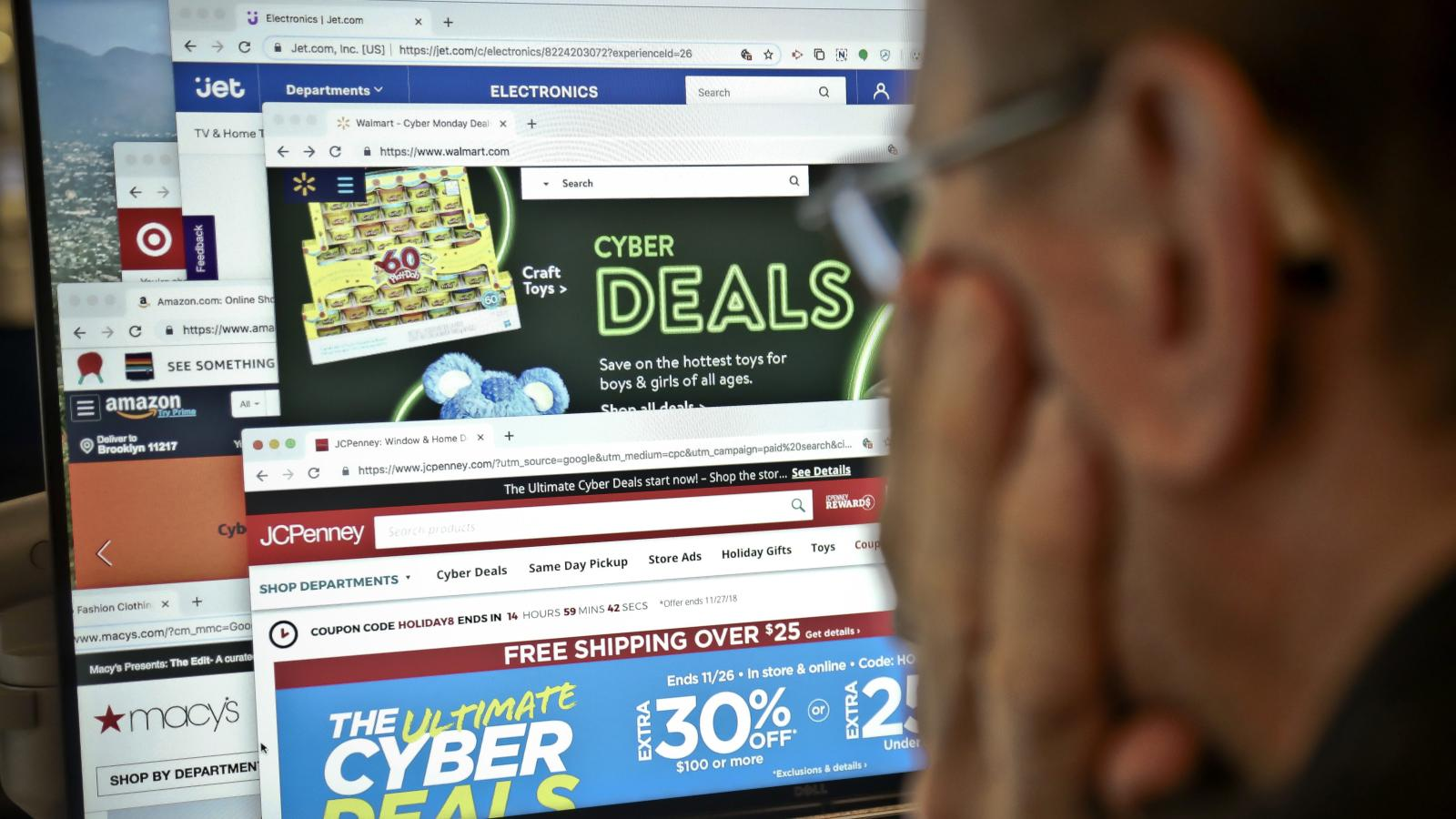
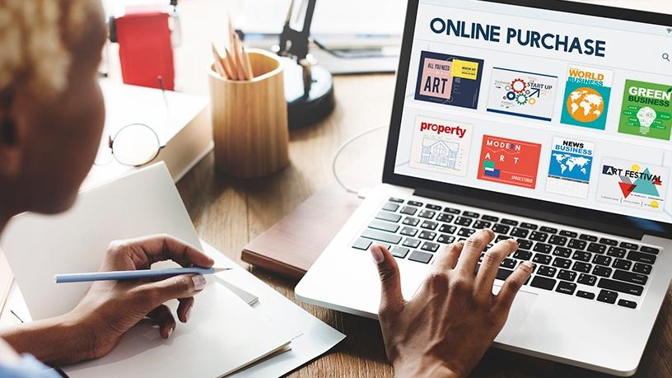
What is online shopping?
Online shopping is the process whereby consumers directly buy goods or services from a seller in real-time, without an intermediary service, over the Internet. It is a form of electronic commerce. An online shop or virtual store evokes the physical analogy of buying products or services at a shopping center. The process is called business-to-consumer (B2C) online shopping.
Online shops give us the opportunity to shop 24/7, and also reward us with a ‘no pollution’ shopping experience. Cheap deals and better prices are available online, because products come to you directly from the manufacturer or seller without middleman being involved. The choices online are amazing. One can get several brands and products from different sellers all in one place.

Slide 4
Our interview video
Please paste this link on google to view the interview video https://drive.google.com/file/d/1IqlPpCSENgeTpAEsW5NeIh1loDXfQfzX/view?usp=sharing

Slide 5
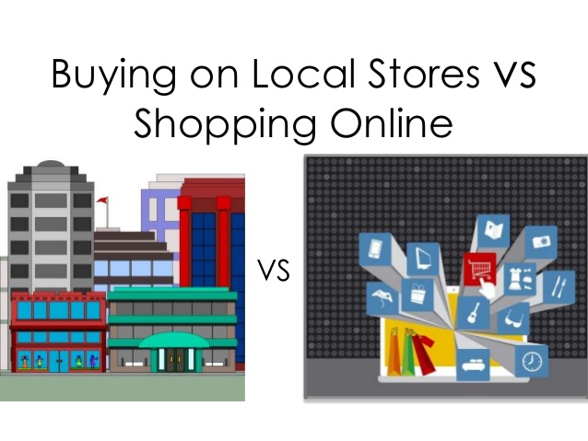
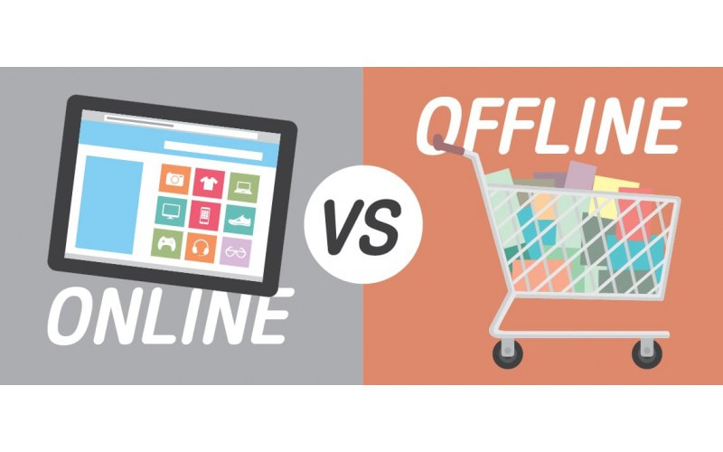
Summary (1)
From the following interviews, we learn the following things:-
People lean more towards the online sector of shopping as it is much more easy and efficient.
We see that many people are switching from Local Shopping to Online Shopping as we can avoid coming in contact with other people to stay safe from Covid-19.
As more people start working from home, they are sticking to basics, stepping outside only to buy essentials and are constantly worried about the risks of getting infected in crowded places like malls and supermarkets. Due to this over 62% of the Indian Population have switched from Local to Online Shopping.
We can see that people only consider shopping locally for meats, vegetables, fruits, etc.

Slide 6
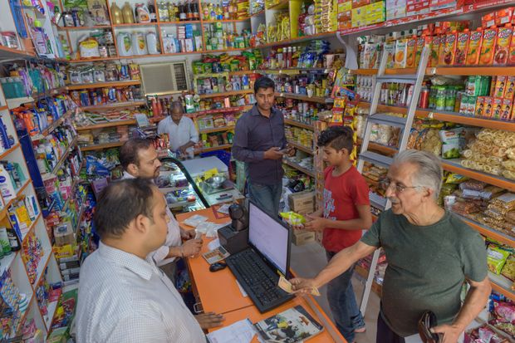
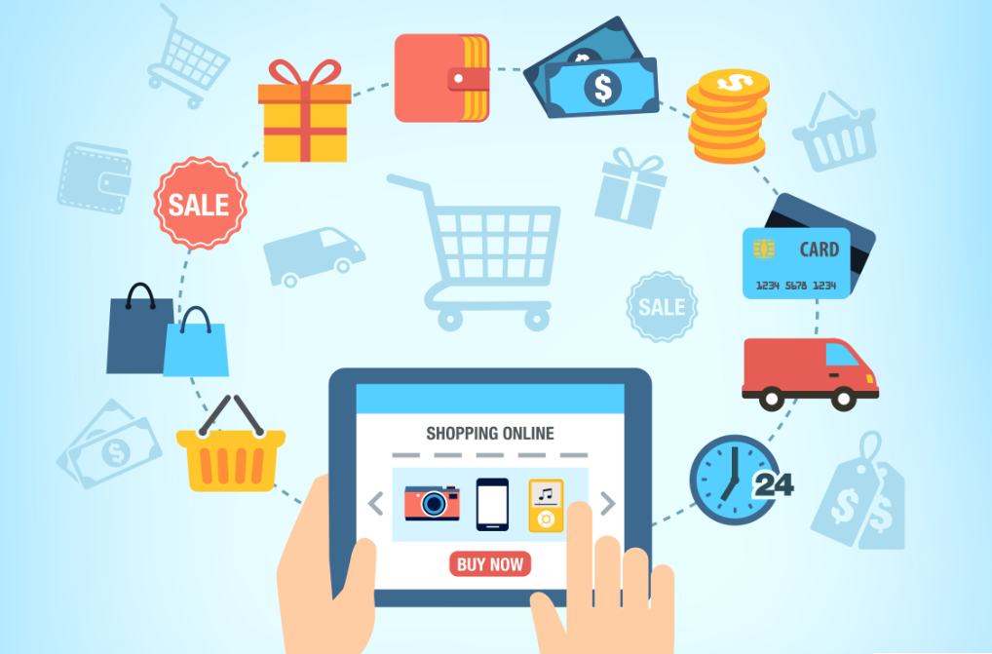
Summary (2)
Online Shopping Companies have also introduced many offers and discounts to help boast sales in their company. This also helps bring many people to do online shopping.
Online shopping can also have its cons like delivering at the wrong address, damaged products and late delivery.
Although people prefer Online shopping over Local Shopping, Local shopping is also very important in our day-to-day life. Because if we urgently need something, we can always go to the local store and quickly buy it whereas while shopping online we have to wait atleast a day or two before you can get the delivery.
Due to increase in online shopping there has also been a rise in scams and frauds. Make sure to keep your personal details safe and not to share it with anyone to be safe from these dangers.

Slide 7
Credits
This project was made with the help of Caspar, Justin and Tanmay. We took the help mostly of members in our family because of the compromises in this lockdown.
We also used the help of the internet to get some information for this project
Thank You

