Slide 1
Group 6: Vandalism (Of Public Properties)
Presented By
Zachery, Jostal, Ralston,
Theopas and Ebrahim

Slide 2
Contents
Introduction
What is Vandalism
Is Vandalism legal or illegal
Do you think Vandalism is a crime
Should we keep Vandalism at bay
How can we control vandalism
Conclusion

Slide 3
Introduction
In this project we are going to talk about Vandalism.
We have chosen this topic because we feel riots are caused due to Vandalism and that is why in this project we have compiled together questions like :-
What is Vandalism,
Why are riots, fights caused due to vandalism and how can we control it.

Slide 4
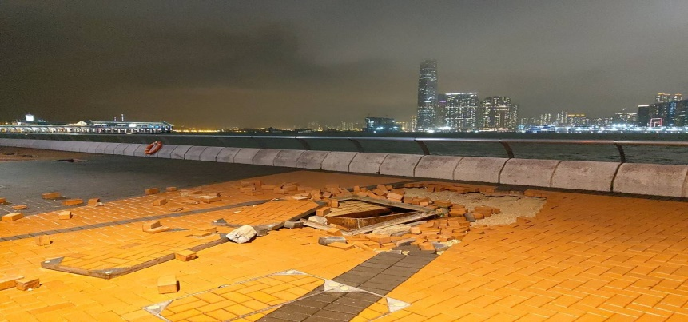
What is Vandalism
Vandalism is a action involving deliberate destruction of private or public property. It includes property damage , graffiti without the owner’s permission.

Slide 5
Interview For Vandalism
Theopas interviewed his father and he said that vandalism means damage to public property. Damage to public property doesn't mean breaking down of a bungalow to build a building it means when you damage a public property with no reason whatsoever.
Example like our project Stan art done on the wall of our school. People have damaged it by spitting on it and by writing on it. This is what is meant by vandalism

Slide 6
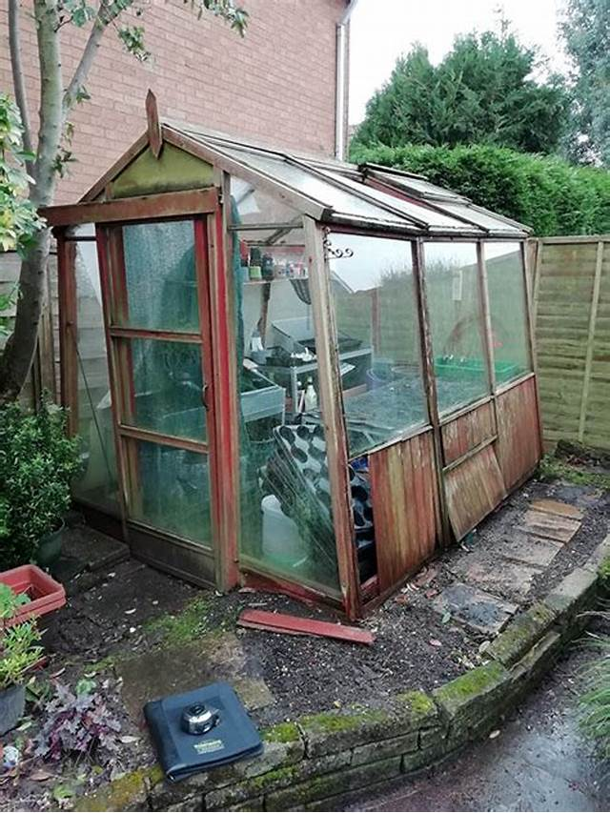
Do You Think Vandalism is a crime
Vandalism is not a serious crime unless the property destroyed is worth a lot of money. Many acts of vandalism are misdemeanors, meaning the maximum penalties include fines and up to a year in the local jail. However, vandalism that results in serious damage to valuable property is a felony.

Slide 7
Interview for Do You Think Vandalism is a crime
Ralston interviewed his uncle and he said that Vandalism is not a crime. It depends on the where is vandalism is done and does the owner of that property want to file a complaint. If the vandal (the person who paints on walls) if have to pay for what damage he/she has done

Slide 8
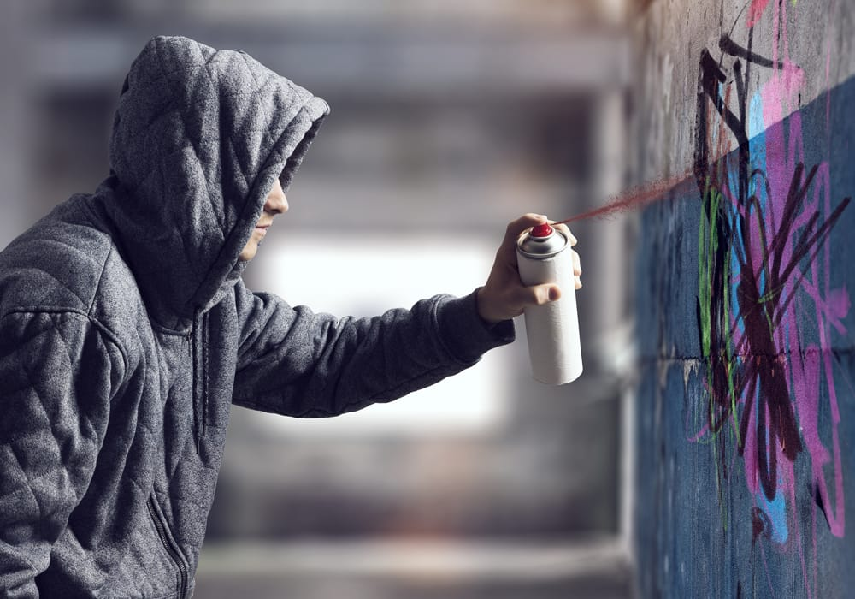
Is Vandalism legal or illegal
Yes vandalism is illegal as it is damage to public property and we as citizens should do something about it. Mostly people see people causing damage and keep quiet. But instead we should inform the police about this because it is a seriously illegal crime. The police should be more strict about this illegal act, because if they are not then it will lead to riots like it has it will lead to a major crime

Slide 9
Interview for Is Vandalism legal or illegal
Jostal interviewed his uncle and asked him is vandalism legal or illegal, he said that yes vandalism is illegal because it is damage to public property. If people do it without permission then it is vandalism, but if it is done with permission like breaking down part of the house to make it bigger. Some people miss understand it. Vandalism is illegal and we should observe anyone practicing it

Slide 10
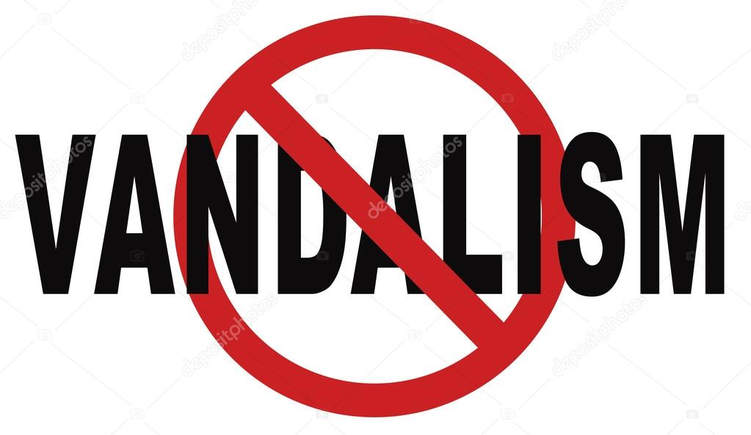
SHOULD WE KEEP VANDALISM AT BAY
Yes, We Should keep vandalism at bay because Vandalism is a type of crime and Many people make the mistake of thinking that Vandalism is a very small crime to report to the police. At least, timely reporting can allow the police to increase presence in the area to protect your neighbors and prevent your location from being hit again

Slide 11
INTERVIEW FOR SHOULD WE KEEP VANDALISM AT BAY
Ibrahim interviewed his mom and she said that we should keep Vandalism at bay and we can control it by keeping security and installing CCTV cameras, spreading awareness in the neighbourhood and in the society, and taking legal actions on people doing vandalism by complaining in the Police Station.

Slide 12
Thank You

